Slide 1
Systems and Properties
Signals and Systems Fall 2020
Prof. Dr. Adnan Kavak
Computer Engineering
Kocaeli University
Textbook: Linear Systems and Signals, B.P. Lathi
This slides are used in EE313 course at the University of Texas at Austin.
They are adopted in this course with Courtesy of Prof. Brian L. Evans

Slide 2
Systems
A system is a transformation from
  One signal (called the input) to
  Another signal (called the output or the response)
Continuous-time systems with input signal x and output signal y (a.k.a. the response):
  y(t) = x(t) + x(t-1)
  y(t) = x²(t)
Discrete-time examples
  y[n] = x[n] + x[n-1]
  y[n] = x²[n]
x(t)
y(t)
System
x[n]
y[n]
System
3 - <number>

Slide 3
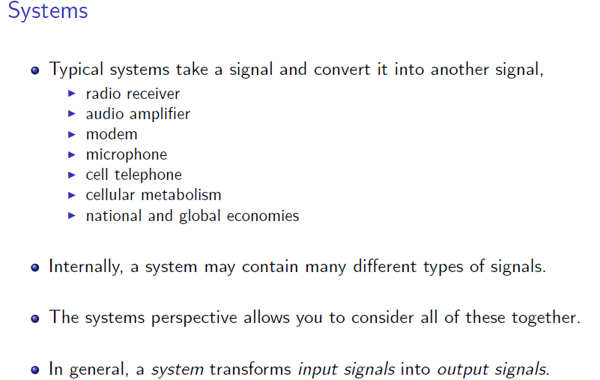
Systems
3 - <number>

Slide 4
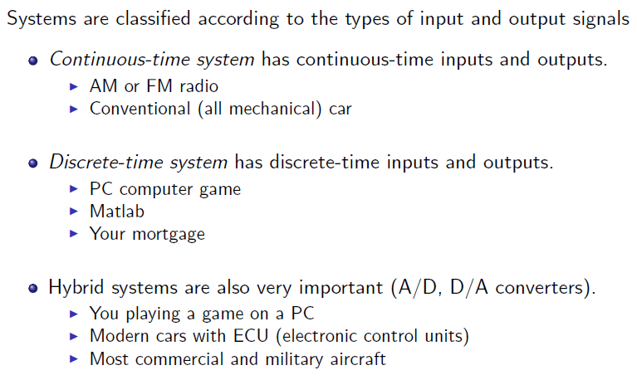
Types of Systems
3 - <number>

Slide 5
System Properties: 1) Linearity
Given a system
  y(t) = f ( x(t) )
System is linear if it is both
  Homogeneous: If we scale the input signal by constant a, output signal is scaled by a for all possible values of a
  Additive: If we add two signals at the input, output signal will be the sum of their respective outputs
Response of a linear system to all-zero input?
x(t)
y(t)
System
3 - <number>

Slide 6
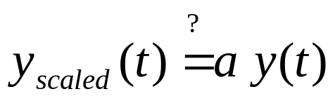
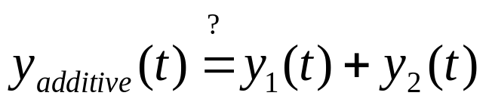
Testing for Linearity Property
Quick test
  Whenever x(t) = 0 for all t,
  then y(t) must be 0 for all t
  Necessary but not sufficient condition for linearity to hold
  If system passes quick test, then continue with next test
Homogeneity test
Additivity test
x(t)
y(t)
System
a x(t)
y_{scaled} (t)
System
x₁(t) + x₂(t)
y_{additive} (t)
System
3 - <number>

Slide 7

Examples
Identity system. Linear?
  Quick test? Let x(t) = 0. y(t) = x(t) = 0. Passes. Continue.
  Homogeneity test?
  Additivity test?
  Yes, system is linear
x(t)
y(t)
a x(t)
y_{scaled} (t)
System
x₁(t) + x₂(t)
y_{additive} (t)
System
3 - <number>

Slide 8

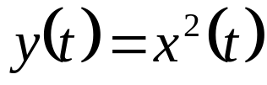

Examples
Squaring block. Linear?
  Quick test? Let x(t) = 0. y(t) = x²(t) = 0. Passes. Continue.
  Homogeneity test?
  Fails for all values of a. System is not linear.
Transcendental system. Linear?
  Answer: Not linear (fails quick test)
x(t)
y(t)
a x(t)
y_{scaled} (t)
System
3 - <number>

Slide 9


Examples
Scale by a constant (a.k.a. gain block)
Amplitude modulation (AM) for transmission
x(t)
y(t)
x(t)
y(t)
  Two equivalent graphical syntaxes
  y(t) = A x(t) cos(2 π f_{c} t)
  f_{c} is non-zero carrier frequency
  A is non-zero constant
x(t)
y(t)
A
cos(2 π f_{c} t)
Used in AM radio, music synthesis, Wi-Fi and LTE
3 - <number>

Slide 10


Examples
Ideal delay by T seconds. Linear?
  Consider long wire that takes T seconds for input signal (voltage) to travel from one end to the other
  Initial current and voltage at every point on wire are the first T seconds of output of the system
  Quick test? Let x(t) = 0. y(t) = 0 if initial conditions (initial currents and voltages on wire) are zero. Continue.
  Homogeneity test?
  Additivity test?
x(t)
y(t)
3 - <number>

Slide 11






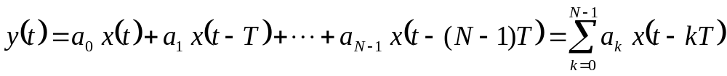
Examples
Tapped delay line
  Linear?
Each T represents a delay of T time units
…
There are N-1 delays
…
Continuous
Time System
Σ
3 - <number>

Slide 12
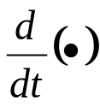
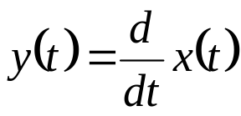
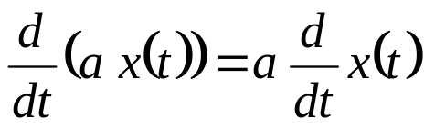
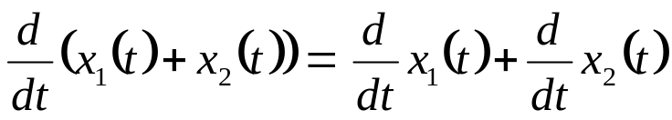
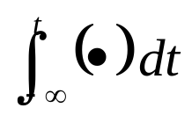
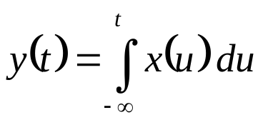
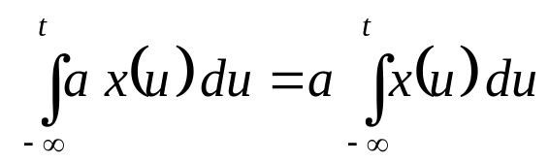
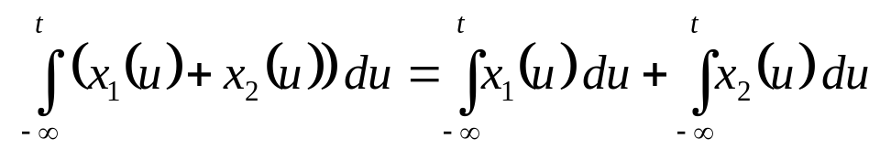
Examples
x(t)
y(t)
Differentiation
  Needs complete knowledge of x(t) before computing y(t)
Integration
  Needs to remember x(t) from –∞ to current time t
  Quick test? Initial condition must be zero.
Tests
x(t)
y(t)
Tests

Slide 13
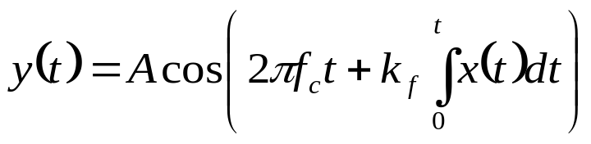
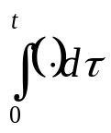

Examples
Frequency modulation (FM) for transmission
  FM radio:
  f_{c} is the carrier frequency (frequency of radio station)
  A and k_{f} are constants
  Answer: Nonlinear (fails both tests)
Linear
Linear
Nonlinear
Nonlinear
Linear
x(t)
k_{f}
+
A
y(t)
2πf_{c}t
3 - <number>

Slide 14
System Properties: 2) Time-Invariance
A system is time-invariant if
  When the input is shifted in time, then its output is shifted in time by the same amount
  This must hold for all possible shifts
If a shift in input x(t) by t₀ causes a shift in output y(t) by t₀ for all real-valued t₀, then system is time-invariant:
x(t)
y(t)
System
Does y_{shifted}(t) = y(t – t₀) ?
x(t – t₀)
y_{shifted}(t)
3 - <number>

Slide 15
Examples
Identity system
  Step 1: compute y_{shifted}(t) = x(t – t₀)
  Step 2: does y_{shifted}(t) = y(t – t₀) ? YES.
  Answer: Time-invariant
Ideal delay
  Answer: Time-invariant if initial conditions are zero
x(t)
x(t-t₀)
t
t₀
t
y(t)
y_{shifted}(t)
initial conditions do not shift
T
t
T
T+t₀
t
3 - <number>

Slide 16


Examples
Transcendental system
  Answer: Time-invariant
Squarer
  Answer: Time-invariant
Other pointwise nonlinearities?
  Answer: Time-invariant
Gain block
x(t)
y(t)
x(t)
y(t)
3 - <number>

Slide 17
Examples
Tapped delay line
  Time-invariant?
Each T represents a delay of T time units
…
There are N-1 delays
…
Continuous
Time System
Σ
3 - <number>

Slide 18
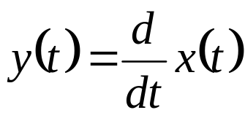
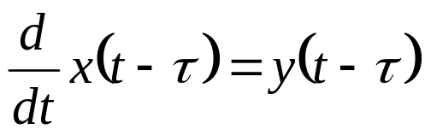
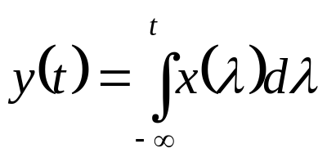
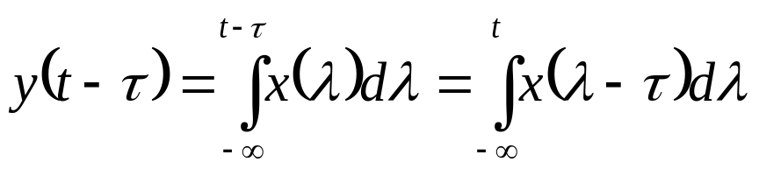
Examples
Differentiation
    Needs complete knowledge of x(t) before computing y(t)
  Answer: Time-invariant
Integration
  Needs to remember x(t) from –∞ to current time t
  Answer: Time-invariant if initial condition is zero
  Test:
3 - <number>

Slide 19
Examples
Amplitude
modulation
FM
radio
Time-
invariant
Time-
varying
x(t)
A
y(t)
cos(2πf_{c}t)
Time-
invariant
Time-
invariant
Time-
varying
Time-
invariant
Time-
invariant
x(t)
k_{f}
+
A
y(t)
2πf_{c}t
3 - <number>

Slide 20
Examples
Human hearing
  Responds to intensity on a logarithmic scale
  Answer: Nonlinear (in fact, fails both tests)
Human vision
  Similar to hearing in that we respond to the intensity of light in visual scenes on a logarithmic scale.
  Answer: Nonlinear (in fact, fails both tests)
3 - <number>

Slide 21
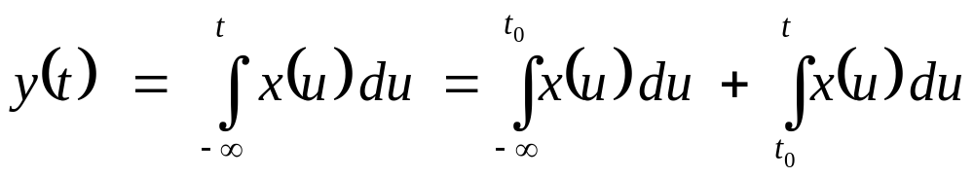
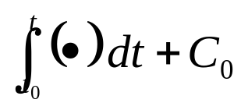
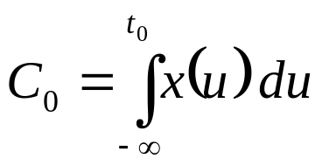
Observing a System
Observe a system starting at time t₀
  Often use t₀ = 0 without loss of generality
Integrator
Integrator viewed for t ≥ t₀
  Linear if initial conditions are zero (C₀ = 0)
  Time-invariant if initial conditions are zero (C₀ = 0)
x(t)
y(t)
Due to initial conditions
x(t)
y(t)
3 - <number>

Slide 22
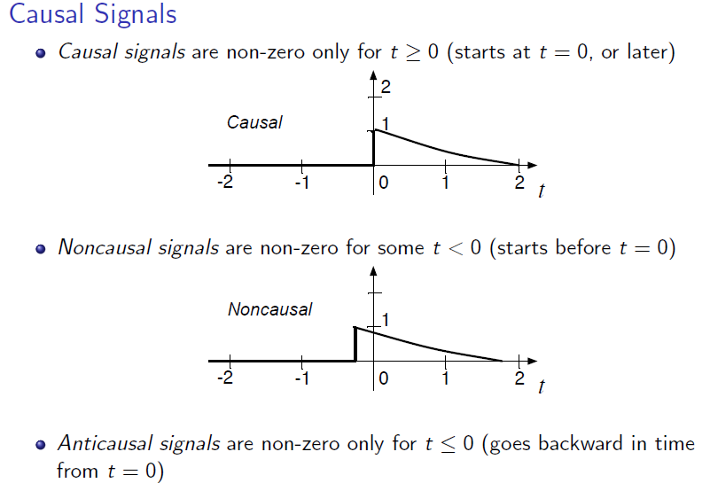
System Properties: 3) Causality
3 - <number>

Slide 23
System Properties: 3) Causality
System is causal if output depends on current and previous (delayed) inputs and previous (delayed) outputs
y(t)=x(t)+x(t+T) non-causal system
y(t)=x(t)+x(t-T) causal system
When a system operates in a time domain, causality is generally required
For digital images, causality often not an issue
  Entire image is available
  Could process pixels row-by-row or column-by-column
  Process pixels from upper left-hand corner to lower right-hand corner, or vice-versa
3 - <number>

Slide 24
Systems Properties: 4) Memoryless
A mathematical description of a system may be memoryless
An implementation of a system may use memory
3 - <number>

Slide 25
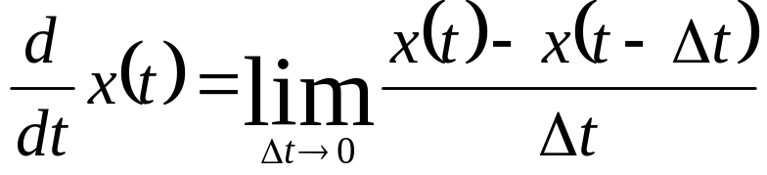
Example #1
Differentiation
  A derivative computes an instantaneous rate of change. Ideally, it does not seem to depend on what x(t) does at other instances of t than the instant being evaluated.
  However, recall
  definition of a
  derivative:
  What happens at a point
  of discontinuity? We could
  average left and right limits.
  As a system, differentiation is not memoryless. Any implementation of a differentiator would need memory.
x(t)
t
3 - <number>

Slide 26
Example #2
Analog-to-digital conversion
  Lecture 1 mentioned that A/D conversion would perform the following operations:
  Lowpass filter requires memory
  Quantizer is ideally memoryless, but an implementation may not be
Sampler
lowpass
filter
quantizer
1/T
3 - <number>

Slide 27
Summary
If several causes are acting on a linear system, total effect is sum of responses from each cause
In time-invariant systems, system parameters do not change with time
If system response at t depends on future input values (beyond t), then system is noncausal
System governed by linear constant coefficient differential equation has system property of linearity if all initial conditions are zero
3 - <number>

